Slide 1
Data Analysis for Real Estate Investment using Zillow Data:
Buy to Sell or Buy to Rent?
Haseeb Durrani

Slide 2
Outline
Buy to Sell or Buy to Rent?
Data Source
Exploratory Data Analysis
Shiny App Demonstration
Future Work

Slide 3
Buy to Sell or Buy to Rent?
Real Estate Investment
Why do we care?
Rent to Value Percentage

Slide 4
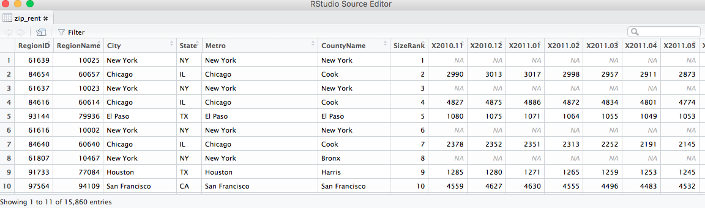
Data Source
Zillow Data
78.1 M Single Family Zestimates
Zestimate

Slide 5
Exploratory Data Analysis

Slide 6
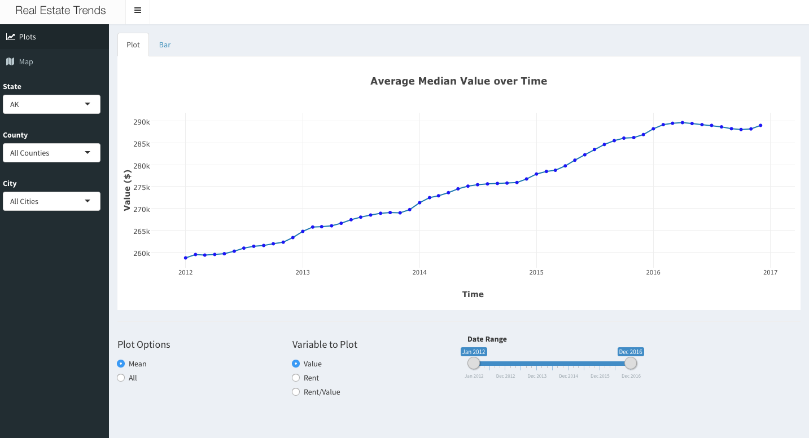

Slide 7
Future Work
More Data
Predictive Data Analysis

Slide 8
Thank you for your time Any Questions?

